Slide 1

Applying Deep Reinforcement learning to Sonic the Hedgehog 2
Final project, Deep learning
Eyþór Einarsson
Notes:
1

Slide 2
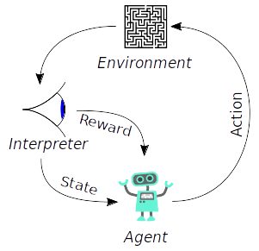
Reinforcement learning:
A software agent learns to behave in an environment
The agent sees an interpretation of the environments state takes some action affecting the environment and then receives a reward and some new state.
The goal is to maximize this reward
Notes:
Extreme learning machine is an emerging approach that outperforms some other methods such as conventional backpropagation feed-forward neural networks an support vector machines in some aspect
<number>

Slide 3
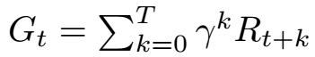
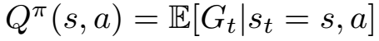
Deep Q-learning (DQN):
Learn a action-value function Q(state, action) for possible state-action pairs.
Q function just tells us how much future rewards the agent will get by following the defined policy.
CNN used to estimate the Q-function.
Algorithm performs the action that gives the maximum (epsilon-greedy) Q value for a particular state while also updating the Q-value estimator with gradient descent.
Only reference I found for the time it takes to train DQN
was 10 days trained to play Atari games.

Slide 4
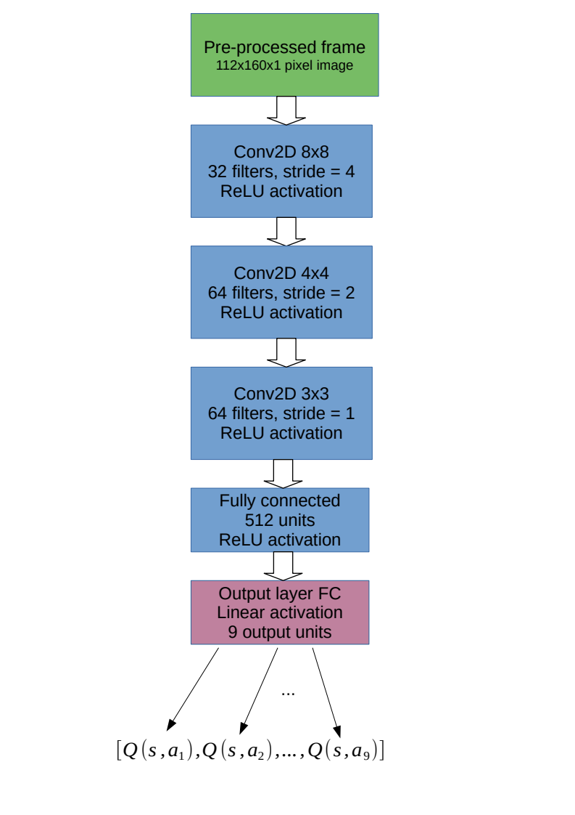




Reward:
State
Action
Reward
Notes:
<number>

Slide 5
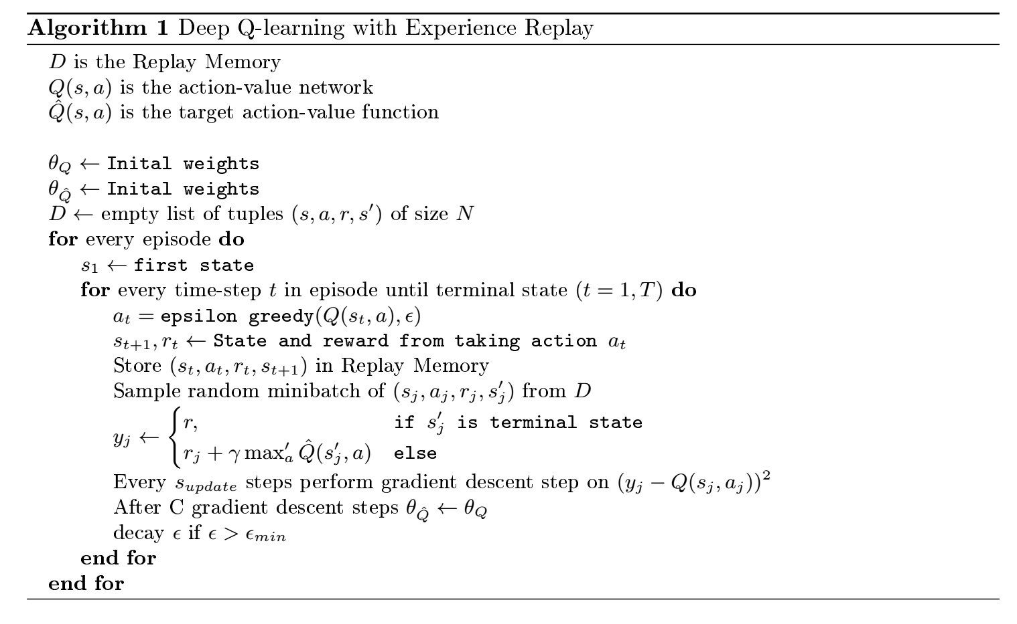
Notes:
Extreme learning machine is an emerging approach that outperforms some other methods such as conventional backpropagation feed-forward neural networks an support vector machines in some aspect
<number>

Slide 6
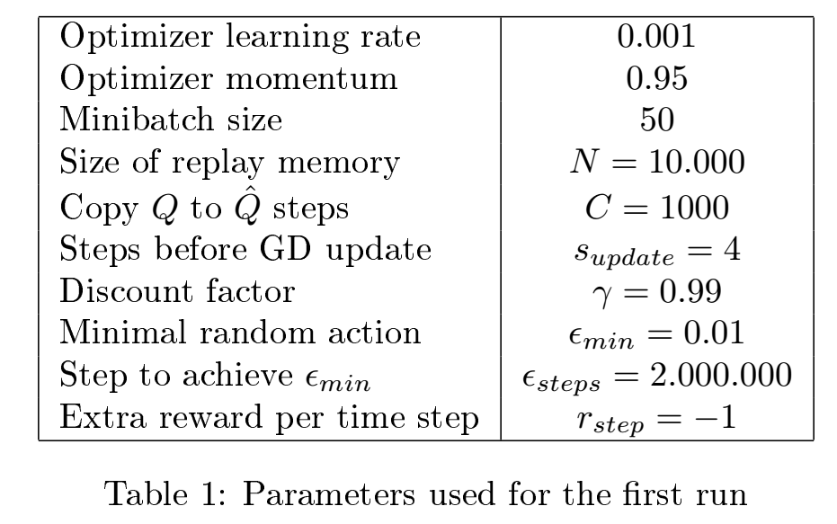
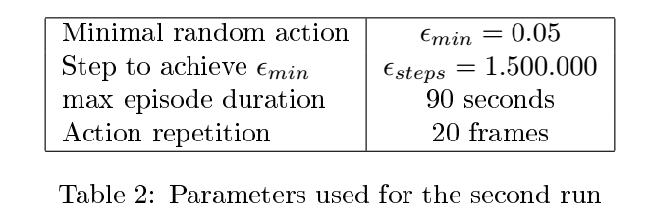

Not able to finish the level after 6 days of training
Finishes the level after 48h of training …. somtimes

Slide 7
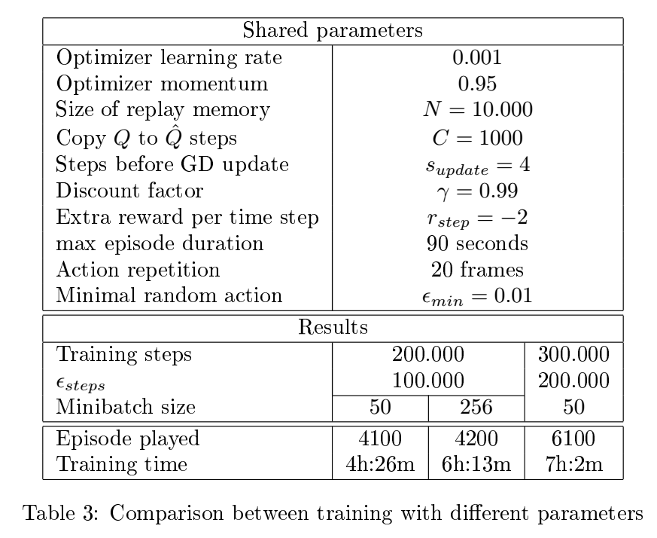
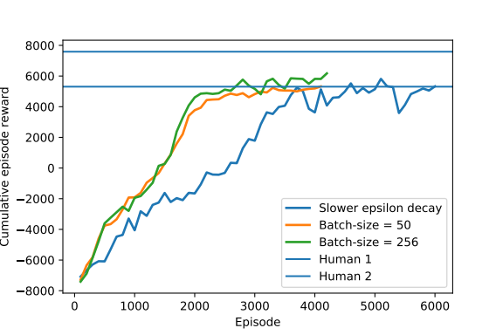

Slide 8
Thank you!
Questions?

